Slide 1
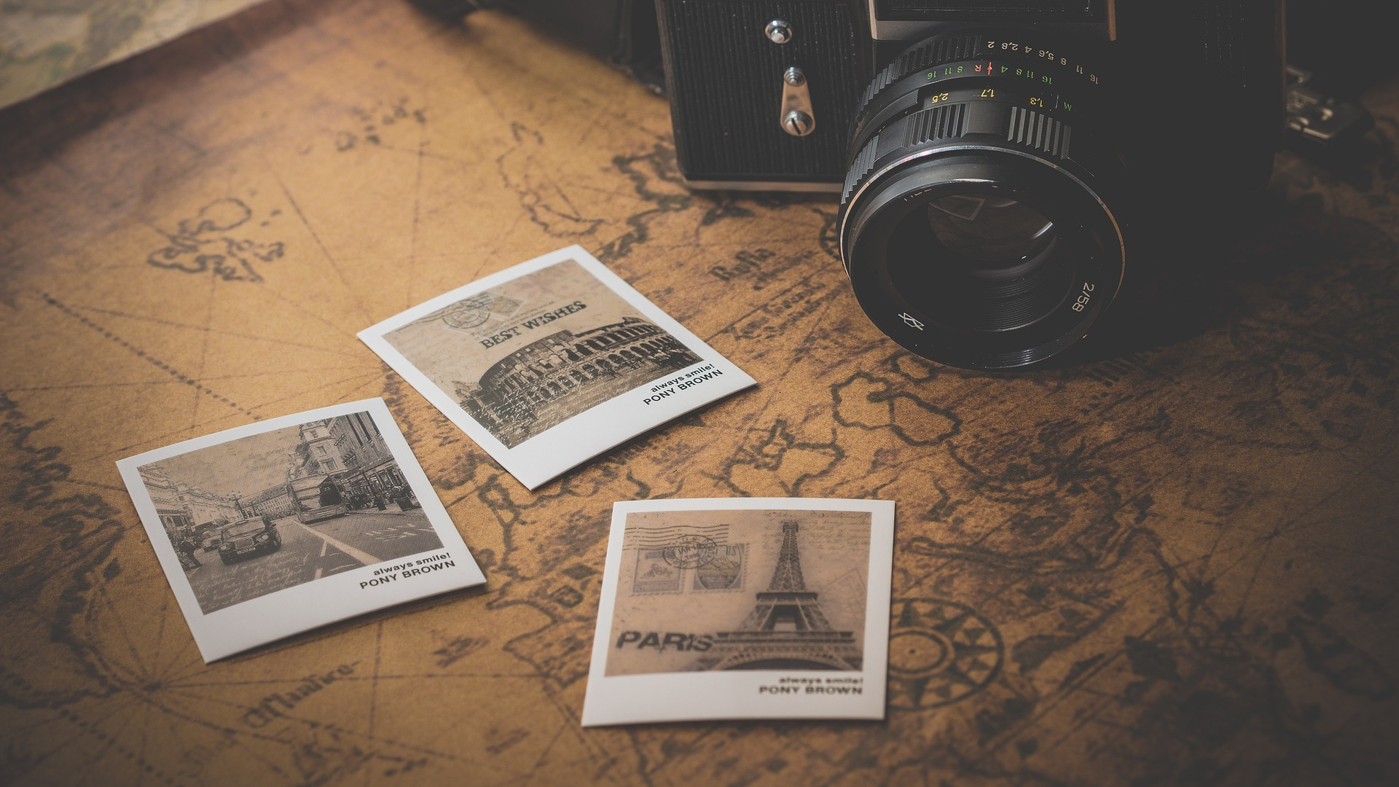
Travel List
Mini Team Project – January 2023
Nameless Ghouls

Slide 2
Overview
Brainstorming IDEA
Determine Roles,
Project Manager
Front End
Back End
Timescale: 7 days.
User Stories
Wireframe

Slide 3
Introduction
User is searching a city – or getting a random city suggestion
Map is returned from Google Maps and 4 pictures from Flickr
They can save the city in favorites and replay info of it
Possible additional features: Weather from API and or Wikipedia about that city

Slide 4
Features:
Travel Bucket List where user can input city or random.
Selected City includes:
Random Images (4)
Maps of the city
Save the selected city
Further stage of development will include:
Ranking review of the city (from google review)
Current weather of the city

Slide 5
API List
Google maps API: https://developers.google.com/maps/documentation/maps-static
GeoNames: http://www.geonames.org/export/web-services.html
The GeoNames geographical database covers all countries and contains over eleven million placenames that are available for download free of charge.
Wikipedia API: https://www.mediawiki.org/wiki/API:Main_page
FLICKR API: images https://www.flickr.com/services/developer/api/
Weather API: https://www.weatherapi.com/docs/

Slide 6
Project Description
User input: type a city name or click randomize
User Pick and select a city
User has the ability to save a place and put it into Favorites (bucket list)
(MVP) Flickr API : Spit out pictures
(MVP) Google maps API show a map of that place.
(2nd Stage of development) Wikipedia API shows general information about that place.
(2nd Stage of development) Weather API Show current weather of that city.

Slide 7
Roles
Project Manager | Front End | Back End
Husain | Husain - Nick | Santi – Iraklis
Setup Repository | HTML | Javascript Framework
Coordinate Repository | CSS | Google Maps API
Organise Links to All API | Styling Guide | Flickr API
Presentation & Documentation | CSS Framework

Slide 8
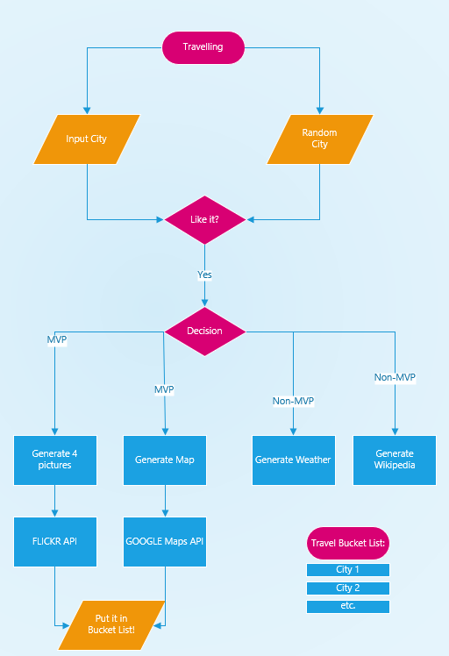
Flowchart

Slide 9
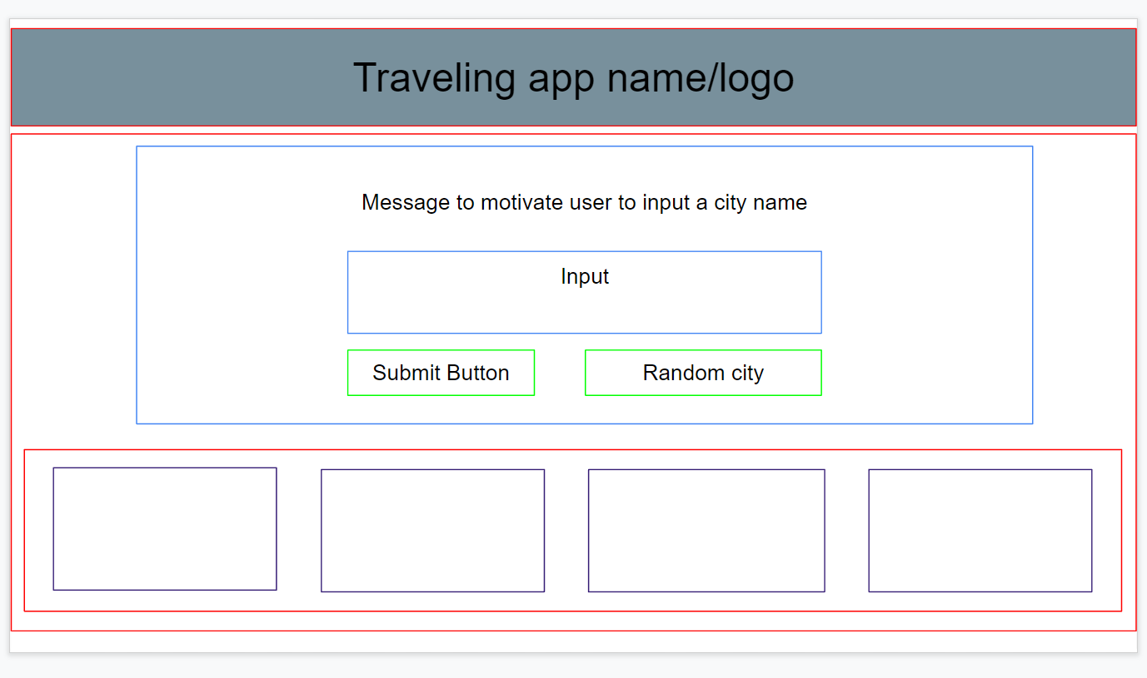
Wireframe - Desktop

Slide 10
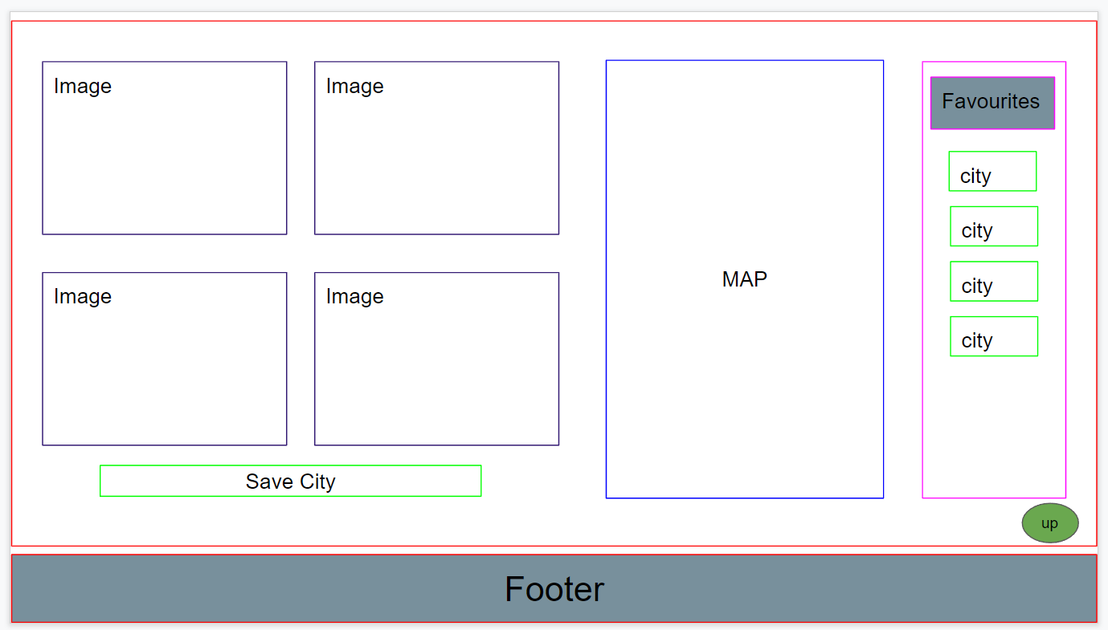
Wireframe - Desktop

Slide 11
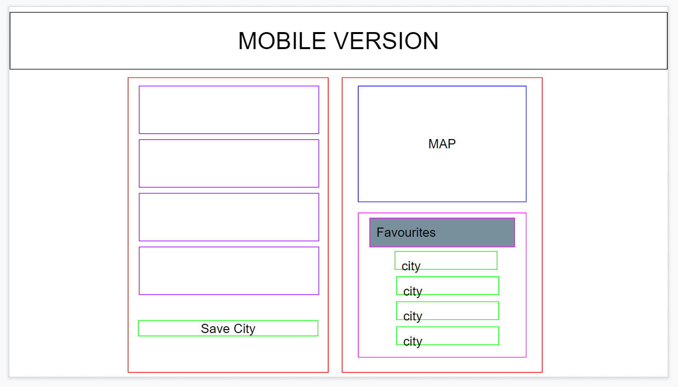
Wireframe - Mobile

